Slide 1
NBAC TSC Slides 16 November 2023 Meeting

Slide 2
16 Nov 2023 NBAC TSC Agenda
1:00 NBAC Co-Chair Opening Remarks – Mr. Kamran Atri, Mr. Thomas Krul
A reminder that our December meeting will be held on 21st.
We are making significant progress on NIEM Model Version 6.0 and anticipate an OASIS Project Specification before the new year
We need you to complete your domain space governance documents before the new year, we will provide additional info later during this meeting
1:10 NIEM Management Office (NMO) Update – Ms. Katherine Escobar
NIEM Commercial – Aubrey Beach
IEPD Demo - Aubrey Beach
26 Oct PGB Meeting Recap - Katherine Escobar
Motions & purchases
2024 Summit Planning - Katherine Escobar

Slide 3
16 Nov 2023 NBAC TSC Agenda (Cont.)
1:25 NIEM Model Version 6.0 Progress & Governance Documents– Steve Sullivan
1:30 NTAC Update – Mr. Jim Cabral
1:35 Communications & Outreach NMO Sub-Committee update – Paul Wormeli
1:40 Floor Open for Discussion
1:45 Questions/Final Remarks

Slide 4
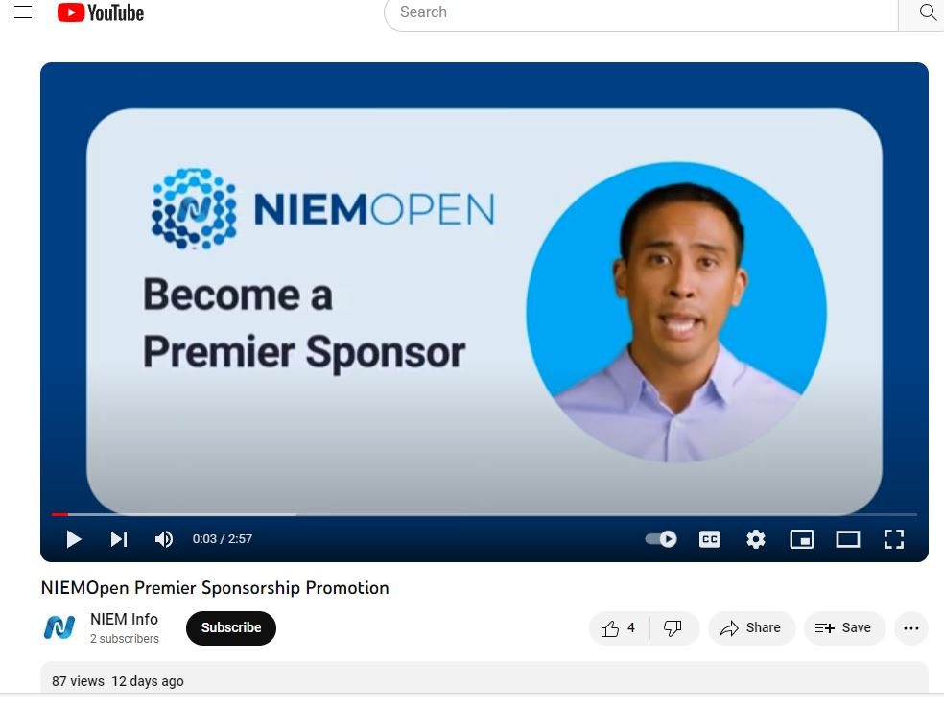
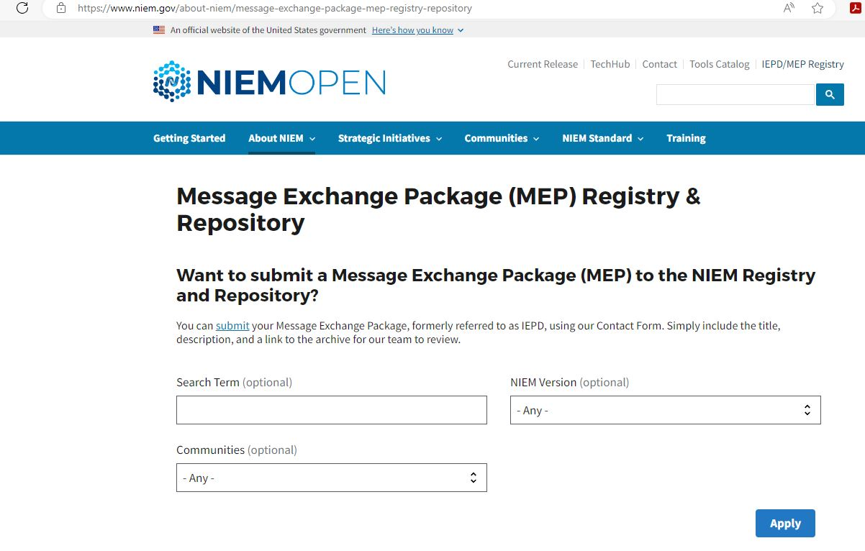
NIEM Video & IEPD/ MEP Repo DemO- Aubrey Beach

Slide 5
26 Oct 2023 PGB Agenda-Katherine Escobar
MOTIONS
Motion to Approve 6.0 Working Draft as PSD 01, Publish to OASIS Library & Approve for 14 Day Public Review
Motion to Approve LearnPress Learning Management System (LMS) as a recurring purchase not requiring annual PGB approval
Motion to Approve purchase of EIN Presswire Services as a recurring purchase not requiring annual PGB approval
Motion to Approve purchase of AWS web hosting services and maintenance as a recurring purchase not requiring annual PGB approval
5 Minute Break
UPDATES
NTAC Update – Jim Cabral
NBAC Update – Thomas Krul / Kamran Atri Documents
Version 6.0 Update
NMO Update – Beth Smalley
Vignettes
NIEMOpen Summit 2024– Jane Harnad
Outreach & Comms SC – Paul Wormeli
Training Snapshot – Shunda Louis
Strategic Comms Update – Shunda Louis & Aubrey Beach
Web Analytics – Aubrey Beach
Next Meeting
Other Business/General Discussion
Questions/Adjourn
Call to Order
TEAMS Link
Meeting Etiquette
Note Takers
Roll Call & Introductions
PGB Voting Members (Sponsors)
PGB Expert Voting Members (TSCs)
PGB Non-Voting Members (TSC Co-Chairs)
TSC Co-Chairs & NIEMOpen Maintainers
Approval of Agenda
Around-the-Horn – PGB Voting Members
Approval of Meeting Minutes from 27 July 2023
OASIS Staff / NIEMOpen Administrator Comments
Q3 Financial Snapshot – Cathie Mayo (OASIS)
Sponsor Update
Transition Progress
GTRI Contract Update – Mark Dotson

Slide 6
PGB HIGHLIGHTS-KATHERINE ESCOBAR
NIENOpen completed a working draft of the NIEM Model Version 6.0 and submitted the draft to the NBAC TSC, NTAC TSC and contributors for review on October 2nd. The internal review was completed October 11.
There were 4 motions before the PGB:
The PGB approved NIEM 6.0 working Draft as PSD01
Publish to OASIS Library
The PGB approved the purchase of AWS hosting services as a reoccurring expenditure as long as budget permits
The PGB approved the purchase of EIN Presswire as a reoccurring expenditure as long as budget permits
The PGB approved the purchased LearnPress LMS at its 27 July Meeting, and configuration and test of the software is ongoing. A motion was approved to update that purchase agreement as a reoccurring expenditure as long as budget permits

Slide 7
HIGHLIGHTS (CONT.)-KATHERINE ESCOBAR
Mark Dotson provided status on the OASIS-GTRI contract
Jane Harnad (OASIS) provided some info on a proposal and initial inquiries to hold a NIEMOpen 2024 Summit in the National Capitol Area.
Cathie Mayo discussed 3rd QTR budget ~$120K General Fund

Slide 8
NIEMOpen MODEL VERSION 6.0 Tentative PSD & PS Timeline
The tentative timeline for progressing NIEM model version 6.0 through the steps leading to approval of a Project Specification draft (PSD) and then Project Specification (PS) is as follows:
Oct 02: NBAC, NTAC, and Domain Subcommittee / COI begin review of the latest working draft
Oct 11: Feedback due, final updates begin
Oct 26: NBAC nominates the latest draft to the PGB for approval as NIEM Model Version 6.0 PSD01 - APPROVED
Nov 2: Chair requests OP Admin publish PSD01
Nov 8: PSD01 published to OASIS library
Nov 9: Ballot request for Special Majority Vote submitted to OP Admin
Nov 9: 14 Day PGB notification of ballot to approve PS01 submitted by PGB Chair
Nov 27: PGB Votes to approve PS01
TBD (~11 Dec) Submit request to publish PS01
TBD (~ 18 Dec) PS01 Published

Slide 9








resources
Follow Us On Twitter
https://twitter.com/NIEMconnects?ref_src=twsrc%5Etfw
Katherine Escobar, katherine.b.escobar.civ@mail.mil, 7575-203-8631
Beth Smalley, beth.l.smalley.civ@mail.mil, 757-203-7177
https://www.niem.gov/
https://niemopen.org/
https://www.linkedin.com/groups/1903175/profile
Git Repos
NIEMOpen: https://github.com/niemopen/
NTAC TSC
https://github.com/niemopen/ntac-admin
NBAC TSC
https://github.com/niemopen/nbac-admin
NMO TSC
https://github.com/niemopen/nmo-admin
https://github.com/niemopen/nmo-training
NIEMOpen Slack Channel: https://niemopen.slack.com/
Mailing Lists
NIEMOpen: https://lists.oasis-open-projects.org/g/niemopen
PGB: https://lists.oasis-open-projects.org/g/niemopen-pgb
NTAC TSC: https://lists.oasis-open-projects.org/g/niemopen-ntactsc
NBAC TSC: https://lists.oasis-open-projects.org/g/niemopen-nbactsc
NMO TSC: https://lists.oasis-open-projects.org/g/niemopen-nmotsc
https://www.youtube.com/channel/UCg9qV22PXLBjG41hc-EwVrQ
MEP Registry & Repository
Restricted Repository-WMAAFIP
NIEM Message Exchange Package Builder

